Slide 1
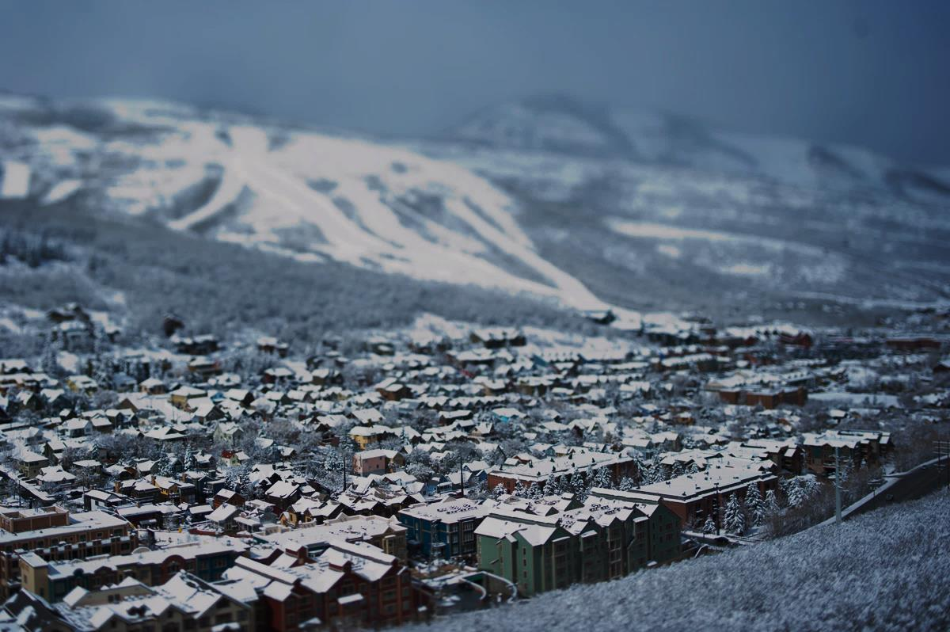

SNOW PARK VILLAGE
PROPOSED PUBLIC-PRIVATE PARTNERSHIP

Slide 2
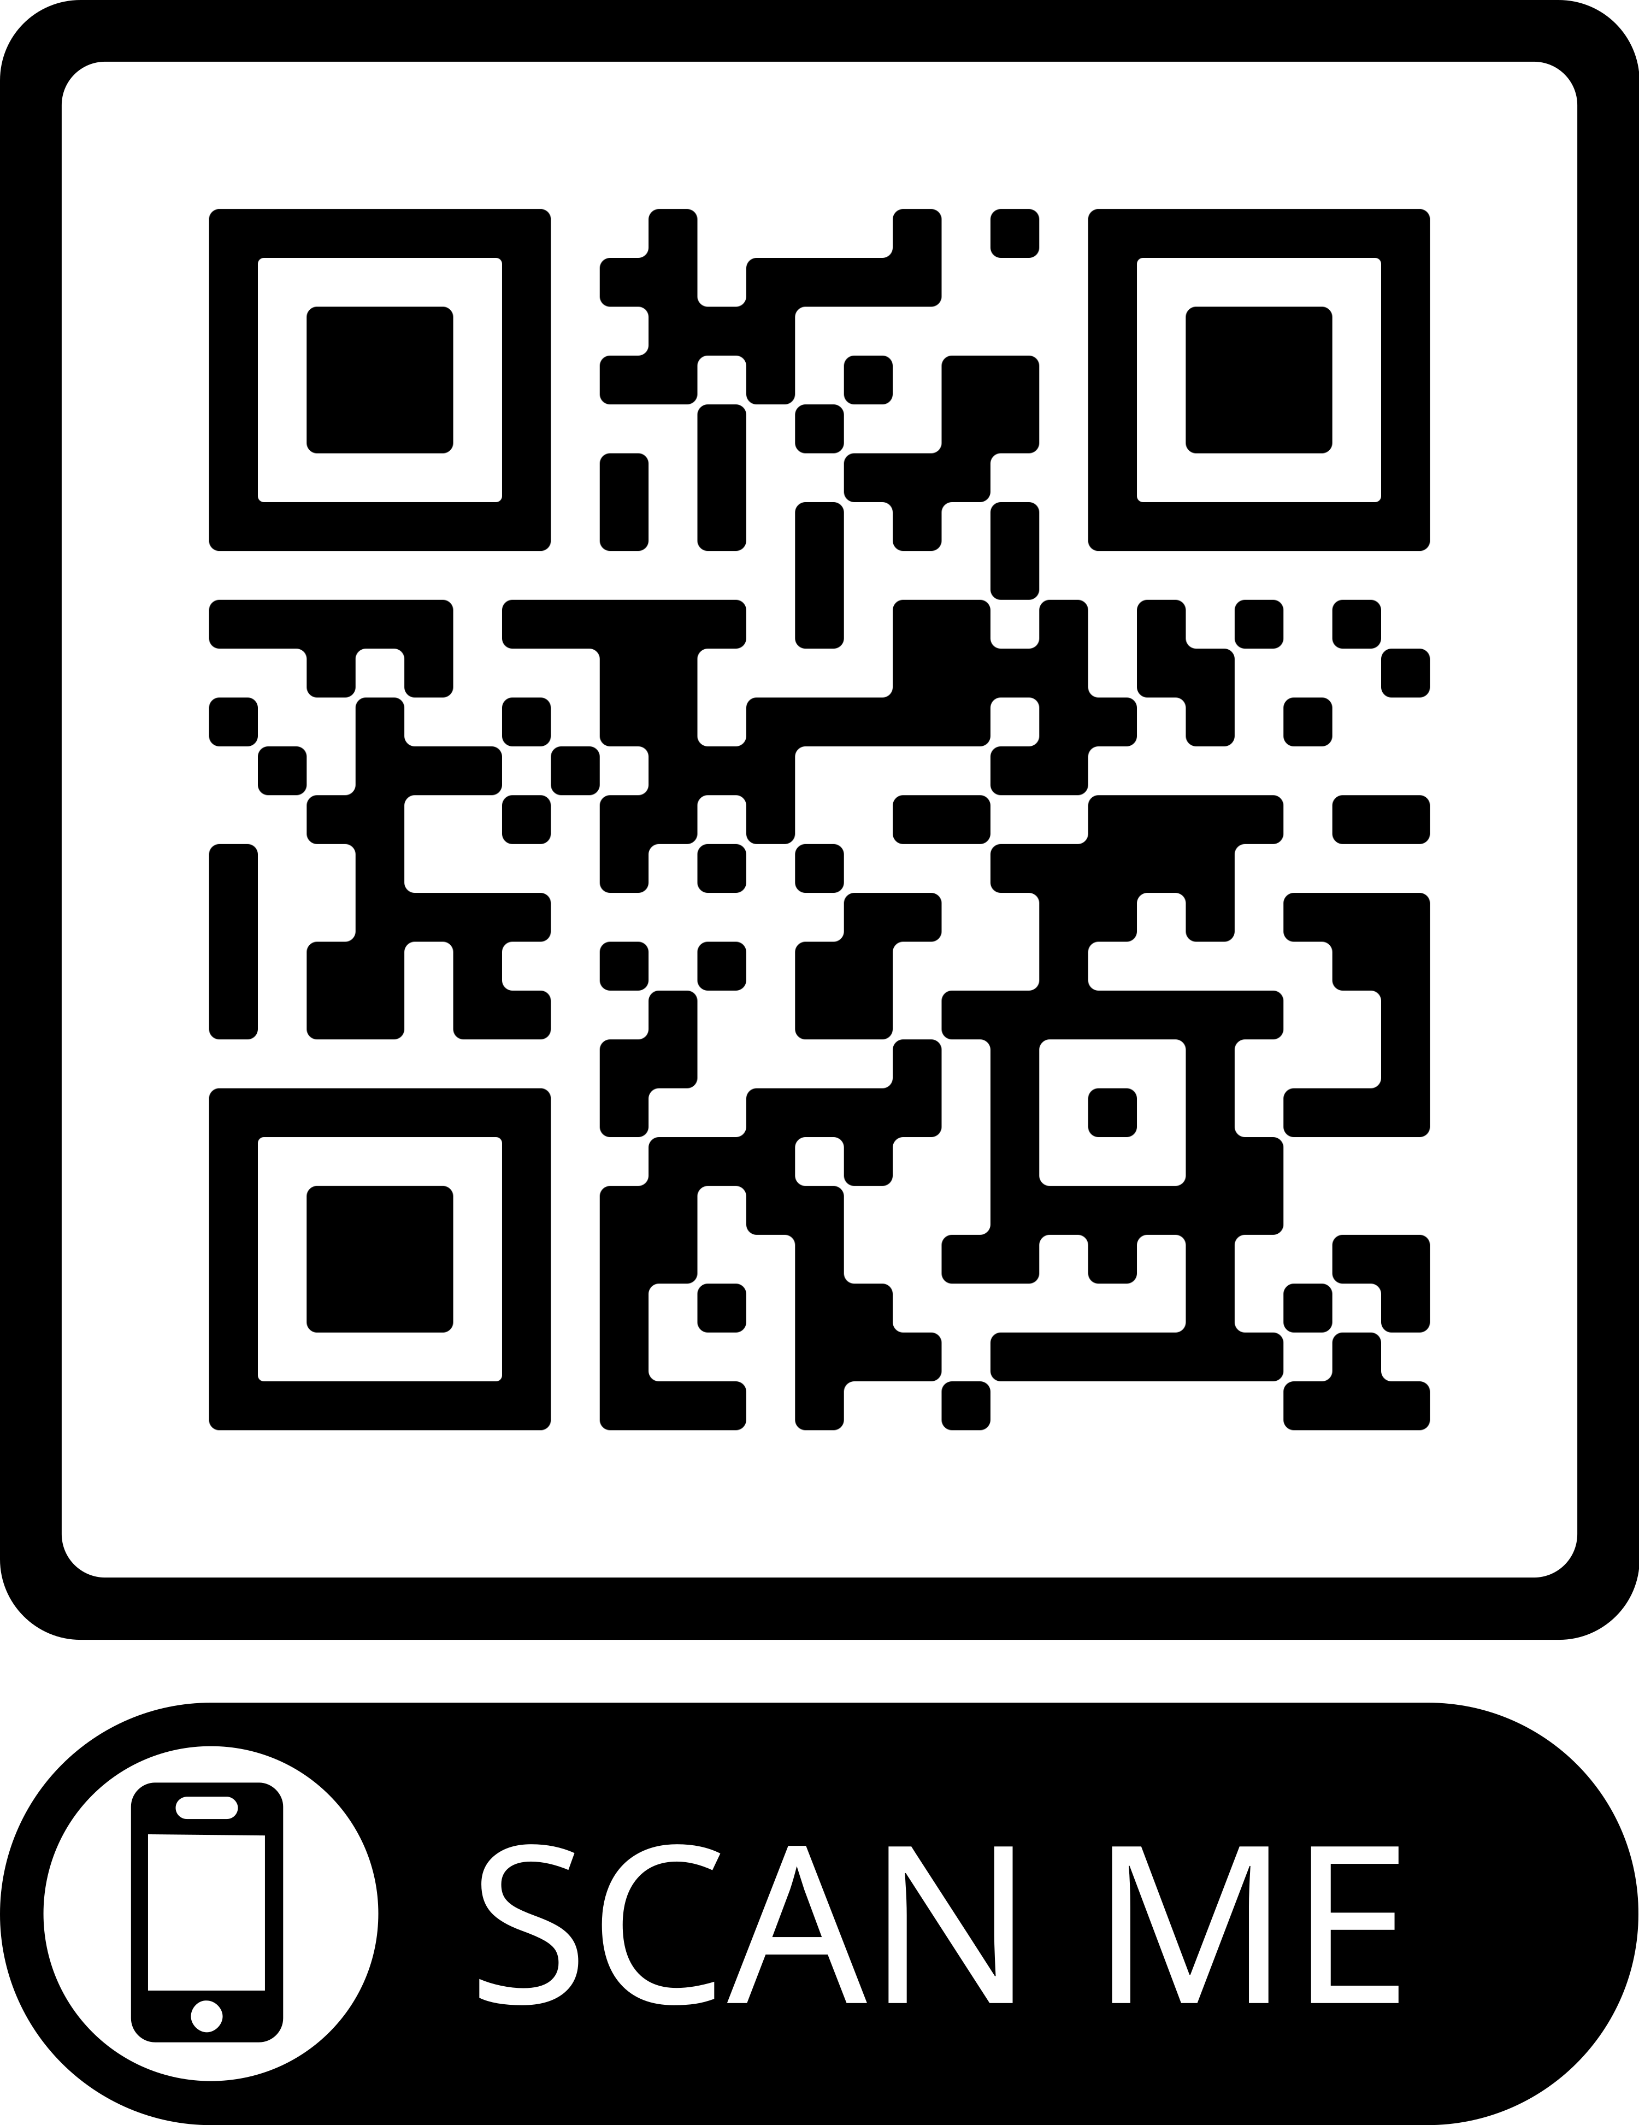
Proposed Public-Private Partnership
Full details of the proposed partnership are published on the City’s website.
Scan the QR code with your phone to view today’s Council packet.

Slide 3
The Public Process
PCMC/DV Proposed
Partnership
Announced
If Ordinance Approved Two Processes on Parallel Path¹
Open Meetings and Public Feedback
City Council Public
Hearing
City Council Considers Ordinance
Multi-Month Period
11/30/23
Council
Meeting
12/05/23
Council
Meeting
12/14/23
Council
Meeting
Parallel Process
Meetings to be Scheduled
Public Private Partnership Agreement (PPPA) Will Be Drafted
If PPPA Approved By Both Entities &…
DV Receive Fee Title, Process Concludes
Today
Planning Commission Will Return to Processing Application
… MPD Approved By Planning Commission
Source: Park City Municipal Corporation. As of December 2023.
1. PPPA’s broad terms to be outlined in ordinance for 12/14/23 should Council direct staff to prepare one.

Slide 4

FAQs

Slide 5
FAQs
Which exact portions of Deer Valley Drive are under consideration for vacation?
Is Deer Valley trying to “take away” public access across portions of their property?

Slide 6
FAQs

Slide 7
FAQs
Will traffic lights be required on Deer Valley Drive?

Slide 8
FAQs
Will the cost to build required affordable housing come from Deer Valley’s $15 million contribution?

Slide 9
FAQs
What can Park City’s $15 million matching contribution be used for?

Slide 10
FAQs
Describe what the Planning Commission’s review of the Snow Park MPD might entail?

Slide 11
FAQs
Clarify the expectations regarding soil mitigation measures

Slide 12
FAQs
How does something like the Pending Ordinance related to Support Commercial within MPDs potentially impact this project?

Slide 13
FAQs
Good Cause
No Material Injury

Slide 14
FAQs
If Council moves forward tonight, when would the formal ROW vacation actually occur, and how?

Slide 15
The Public Process
PCMC/DV Proposed
Partnership
Announced
If Approved, Two Processes on Parallel Path¹
Open Meetings and Public Feedback
City Council Public
Hearing
City Council Considers Ordinance & Resolution
Multi-Month Period
11/30/23
Council
Meeting
12/05/23
Council
Meeting
12/14/23
Council
Meeting
Parallel Process
Meetings to be Scheduled
Public Private Partnership Agreement (PPPA) Will Be Drafted
If PPPA Approved By Both Entities &…
DV Receive Fee Title, Process Concludes
Today
Planning Commission Will Return to Processing Application
… MPD Approved By Planning Commission
Source: Park City Municipal Corporation. As of December 2023.
1. PPPA’s broad terms to be outlined in ordinance for 12/14/23 should Council direct staff to prepare one.

Slide 16
SNOW PARK VILLAGE
PROPOSED PUBLIC-PRIVATE PARTNERSHIP

Slide 17
Proposed Public-Private Partnership
HIGHLIGHTS
$15 million partnership to construct a regionally significant transportation and parking facility.
20% reduction in day skier parking from current peak conditions.
Integration of gondola infrastructure with U.S. Highway 40 to distribute resort access more efficiently across the mountain.
67.1 Affordable Housing Unit Equivalents built within Park City limits and with immediate access to public transit.

Slide 18
Proposed Public-Private Partnership
HIGHLIGHTS
Substantial infrastructure investments at the project site — including roads, intersections, crosswalks, transit, parking structure, and more.
Ensure access to Doe Pass Road for emergency, utility, and public vehicles.
Maintain public access to Deer Valley Drive throughout construction and minimize construction traffic.

